Slide 1

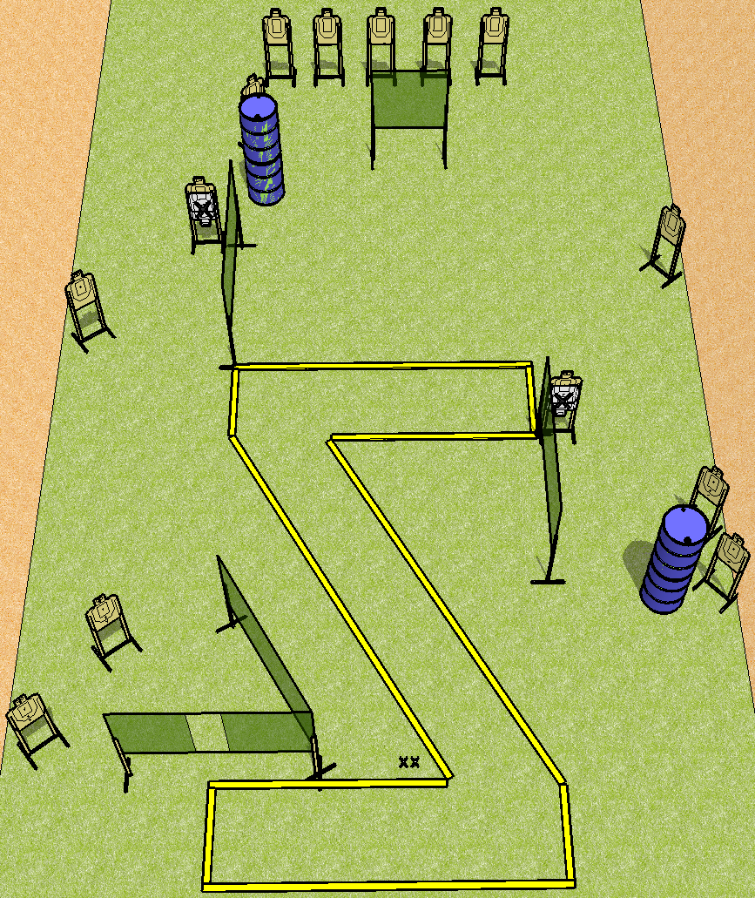
 | Dothan Practical Shooters – USPSA Match Z for Zero Course Designer : Drew Coleman Bay: B1
Round Count 28 rounds 14 USPSA
Equipment List 10 wall feet 16 targets (14 + 2NS)

Slide 2
Z for Zero
Written Stage Briefing
Scoring: Comstock Rounds: 28
Targets: 14
Handgun start position: feet on X’s, wrists below belt. Handgun is loaded and holstered.
PCC start position: feet on X’s, stock on belt. Loaded carbine is held with both hands.
Stage Procedure: on the audible start signal, engage targets as they become available from within the shooting area.

